Slide 1
The Marshmallow Challenge
What is it?
In teams, you will build a tall structure using simple, everyday materials.
Why are we doing this?
This activity encourages teams to experience lessons in collaboration, innovation, and creativity.
Who else has performed this challenge?
It has been done world-wide by thousands of people, from CFOs of big corporations to students at all levels.

Slide 2
Your Tasks
Divide up into teams of four to five people each.
Within the time limit and using only the materials in the paper sack, build a structure that has a single marshmallow at the very top.
At the end, the team with the tallest, stable structure will be declared the winner!

Slide 3
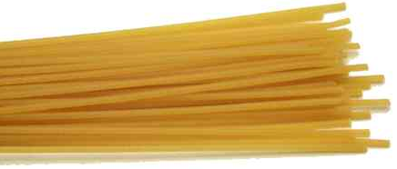
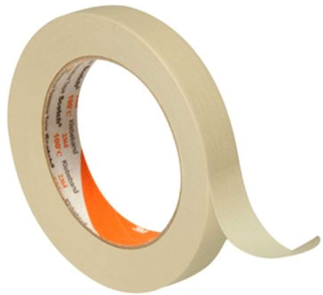
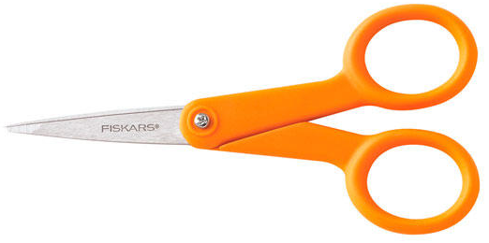
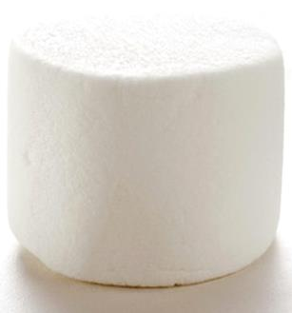
Materials
20 sticks of spaghetti
1 yard of masking tape
1 yard of string
1 pair of scissors
1 marshmallow
Paper sack to hold materials Please do not damage the sack!

Slide 4
The Rules
Build the tallest freestanding structure
Measured from table surface to top of marshmallow
You cannot move the table itself
The entire marshmallow must be on top
Cutting or eating the marshmallow disqualifies the team
Use as much or as little of the kit as you like
You cannot use the paper bag as part of the structure
Breaking up the spaghetti, string, or tape is allowed
You can break the spaghetti and cut the string and tape
The challenge lasts exactly 18 minutes
Teams cannot touch or hold on to the structure when time runs out

